Slide 1
SOURCES, SHADOWS AND SHADING
Dr Mayuri A v r
Senior assistant professor
ViT bhopal

Slide 2
Introduction
Light Source emits light.
A source can be described in terms of radiance.
Emitted radiance is different from reflected radiance
In addition to this, we need to know about the description of the geometry of the source and shadows

Slide 3
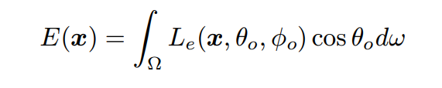
Exitance
The internally generated energy radiated per unit time and per unit area on the radiating surface
Exitance is similar to radiosity
Sources can have radiosity as well as exitance, because energy may be reflected off and energy can be generated within it.
It can be computed as

Slide 4
Qualitative Radiometry
How “bright” surfaces are going to be under various lighting conditions?
How this “brightness” depends on local surface properties?
what a source looks like from the surface?

Slide 5
The radiation arriving at the surface along a particular direction passes through a point on the hemisphere.
If two surface patches have equivalent incoming hemispheres, they must have the same incoming radiation.
Any difference in “brightness” between patches with the same incoming hemisphere is a result of different surface properties.

Slide 6
Sources and their Effects
There are three main types of geometrical source models:
point sources,
line sources and
area sources.

Slide 7
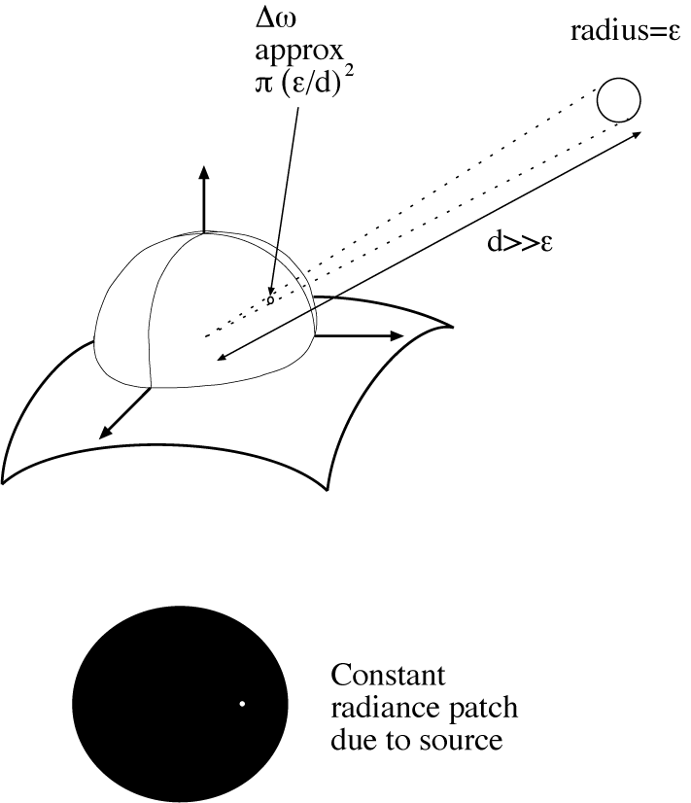

Slide 8
Point Sources
A common approximation is to consider a light source as a point.
It is a natural model to use,
We can obtain a model by modelling the source as a very small sphere that emits light and exitance is constant
Assume that a surface patch is viewing a sphere of radius e, at a distance r away, and that e > r.
Assume the sphere is far away from the patch.
Now the solid angle is Ωs.
This will behave approximately proportional to e² / r²

Slide 9
The pattern of illumination that the source creates on the hemisphere will roughly scale.
As the sphere moves away, the rays leaving the surface patch and striking the sphere move closer together evenly
The contribution from these rays must be very small
If e tends to 0 then no new rays are added and th patch shrinks
Radiosity due to the source is obtained by integrating the pattern cos θ times over the patch of solid angle
Radiosity = ρ (e/r)² E cos θ

Slide 10
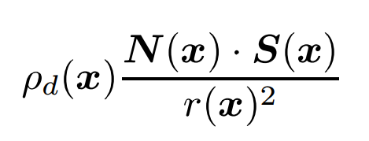
A Nearby Point Source
The angle can be written in terms of N(x) and S(x)
N(x) - the unit normal to the surface and
S(x) – source vector
This is an extremely convenient model, because it gives an explicit relationship between radiosity and shape

Slide 11
A point source at infinity
The sun is far away
As a result, the terms 1/r(x)² and S(x) are essentially constant.
In this case, the point source is at infinity.
radiosity due to a point source at infinity becomes:
B(x) = ρ_{d}(x)(N · S)

Slide 12
Line Sources
A line source has the geometry of a line — a good example is a single fluorescent light bulb.
The radiosity of patches reasonably close to a line source changes as the reciprocal of distance to the source(1/r) (rather than the square of the distance (1/r^2))

Slide 13
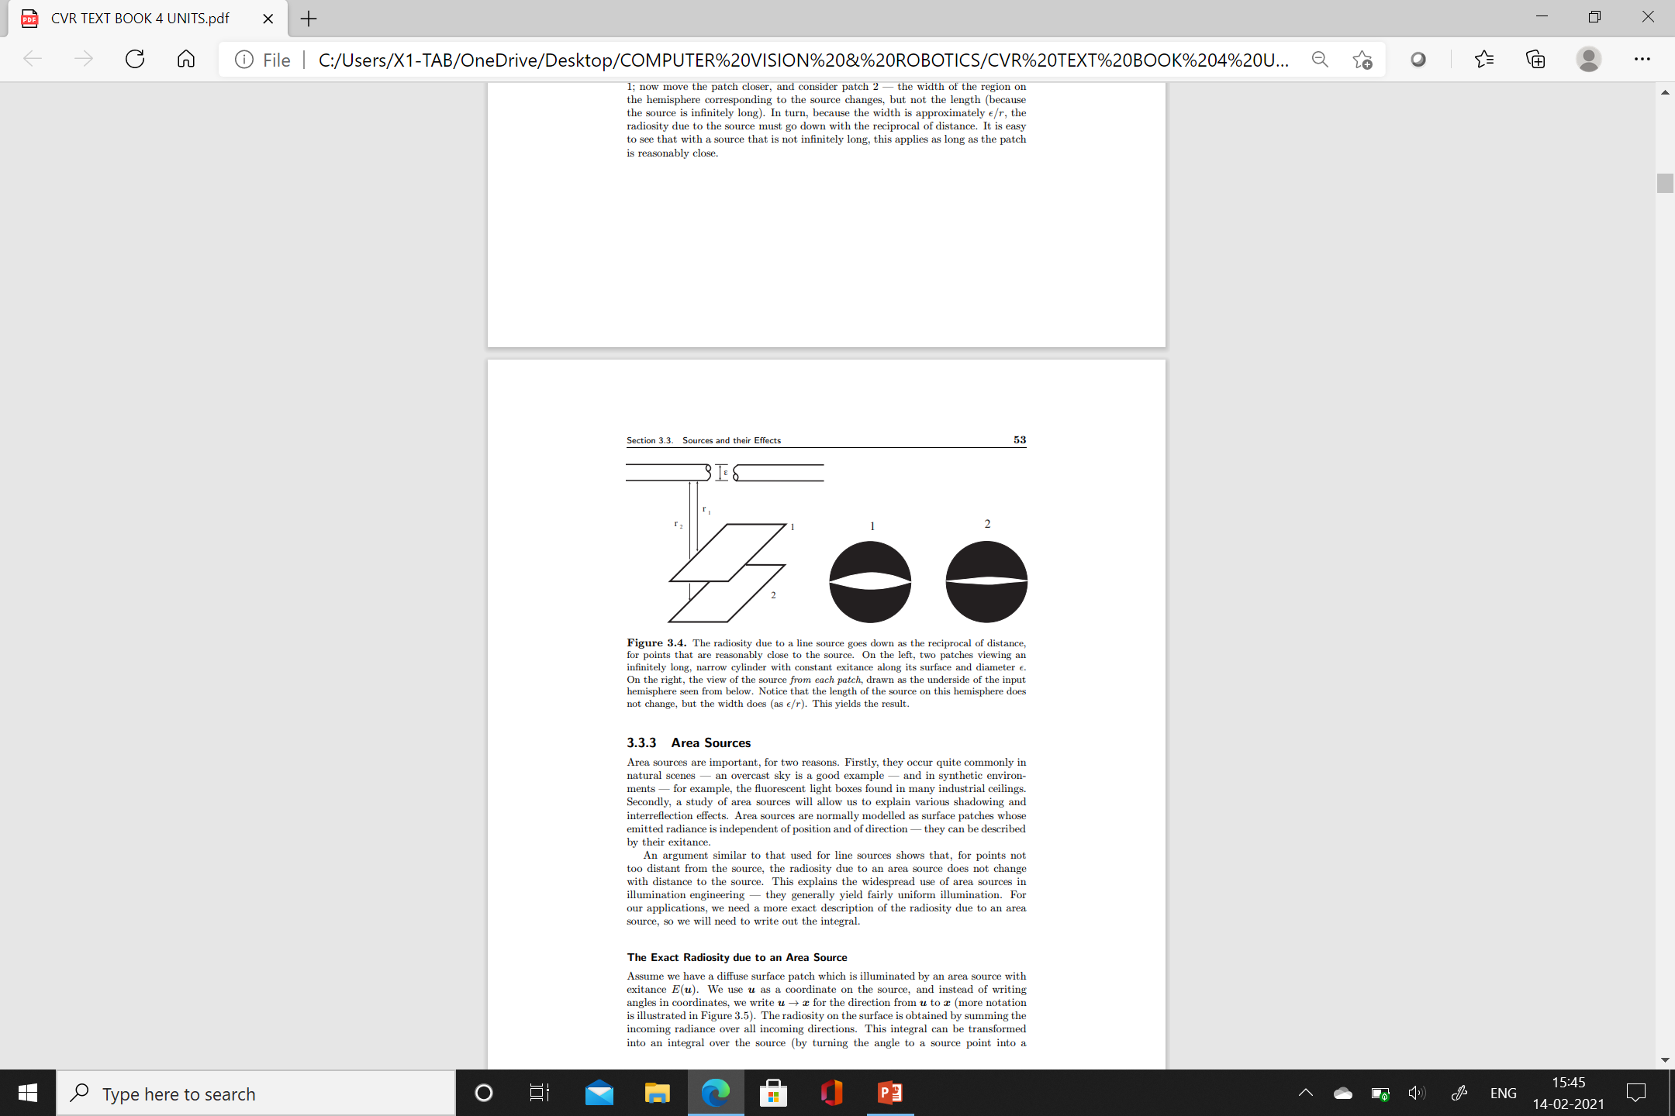

Slide 14
Area Sources
Area sources are important, for two reasons.
1) They occur quite commonly in natural scenes
Ex: an overcast
Synthetic environments
2) A study of area sources will allow us to explain various shadowing and interreflection effects.
Area sources are normally modelled as surface patches
They can be described by their exitance.

Slide 15
Radiosity of an area source
Assume we have a diffuse surface patch
This is illuminated by an area source with exitance E(u).
We use u as a coordinate on the source
Instead of writing angles in coordinates, we write u → x for the direction from u to x
The radiosity on the surface is obtained by summing the incoming radiance over all incoming directions.
This integral can be transformed into an integral over the source

Slide 16
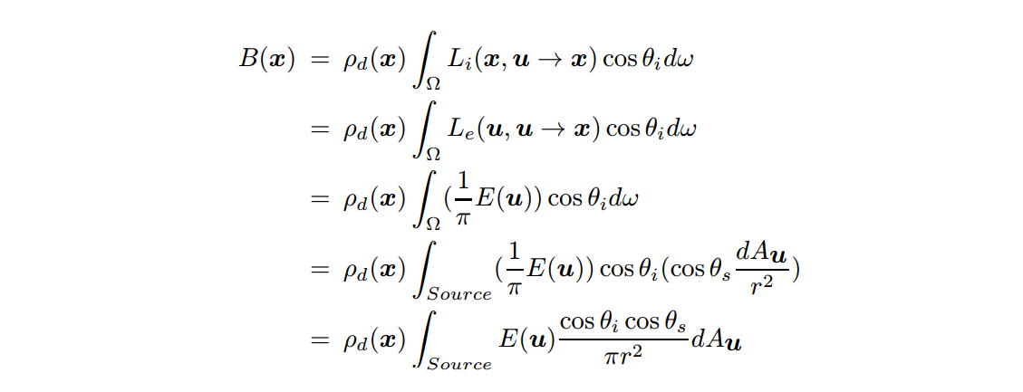

Slide 17
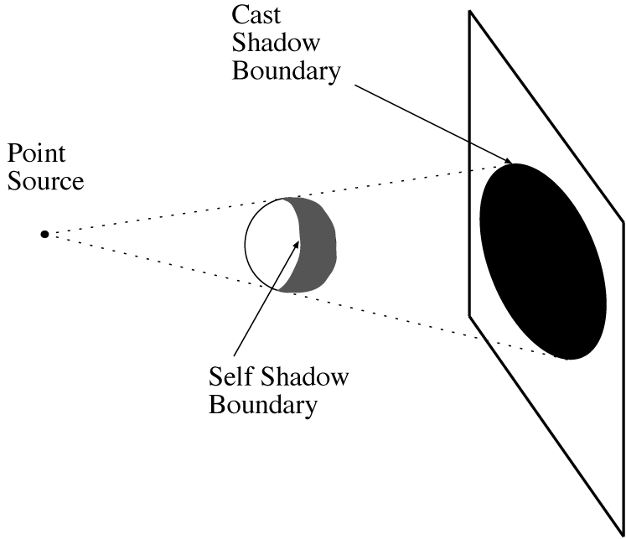
Shadows cast by a point source

Slide 18
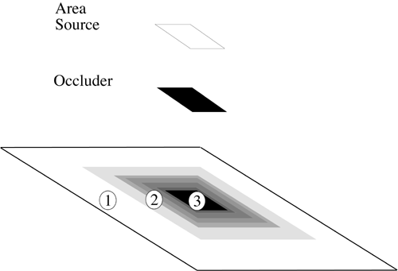
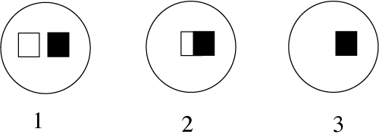
Area Source Shadows

Slide 19
Shading Models
Local shading model
Surface radiosity is due to visibility of sources at each point sources a
Easy to manipulate
Supports simple theories that extract shape information from shading
Global Shading model
surface radiosity is due to radiance reflected from other surfaces as well as from surfaces
Very accurate
Extremely difficult to infer from shading values

